Slide 1
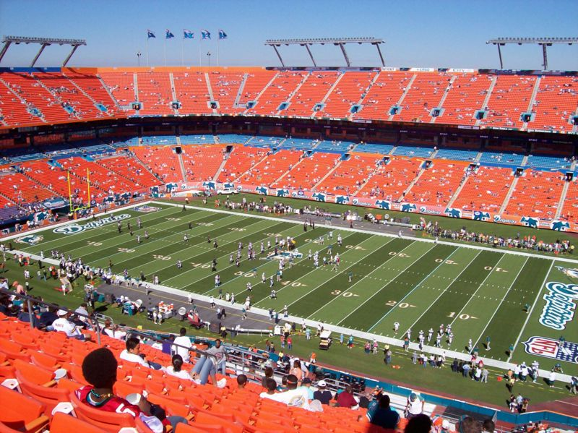
WILDCAT
OFFENSE
PRESENTED BY
Jason Compton

Slide 2
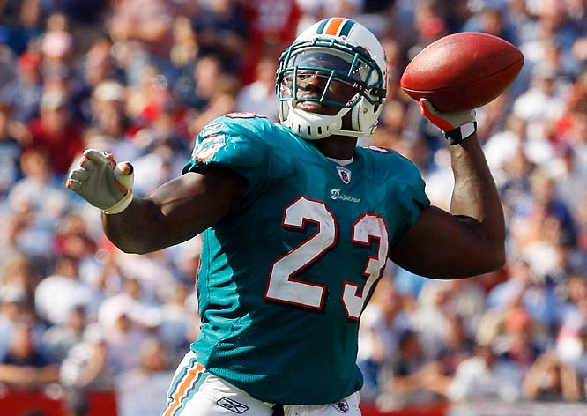
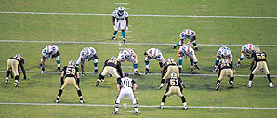
WHY THE WILDCAT?
Numbers Advantage
Simplicity
Deceptive
Ball In Hands Of Best Player
Big Play Opportunities
Defensive Preparation

Slide 3
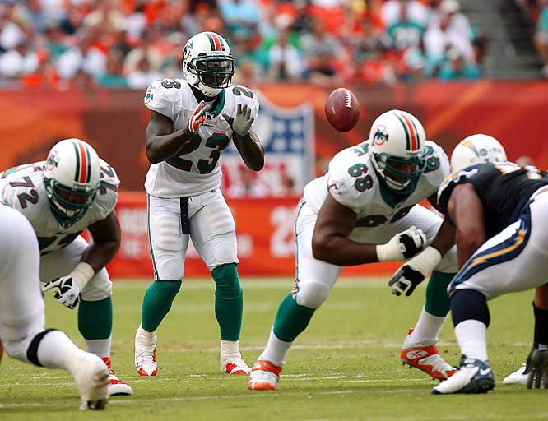
FORMATIONS & PERSONNEL
PERSONNEL
Numbers Advantage
Simplicity
Deceptive
Ball In Hands Of Best Player
Big Play Opportunities
Defensive Preparation
H: Best overall back. Power runner. Ability to run inside the tackles and throw.
Z: Second half back or a WR. Ideally a speed guy who can get around the edge. Q: Must be willing to block. Can be used in trick plays to throw.
F: Must be able to kick out a defensive end, reach, and scoop/cut block.
X: Can be changed with a 2nd TE, must be willing to block and downfield pass threat. Y: Must be able to execute the downblock, reach, and scoop. Pass threat.
OL: Must be aggressive. Execute reach, drive, double-team, pull kick/lead, and scoop.

Slide 4
Jet Sweep
H: Put Z in Jet Motion. Receive snap, hand-off; fake back-side run.
Z: Jet motion. Receive handoff. Read the block of the FB. Q: Stalk block.
F: Pull and lead block. Kick or hook defender.
X: Block man on or force defender. Y: Hard scoop, get up-field and block first color to show.
OL: All reach. Combo end man on LOS. Reach rules.

Slide 5
Jet Sweep

Slide 6
QB Power
H: Put Z in Jet Motion. Fake Jet Sweep. Run hard down hill through 6 hole, read G’s block.
Z: Jet motion. Fake the Jet Sweep, run hard and sell the defense. Q: Stalk block.
F: Kick out end man on LOS.
X: Block man on or force defender. Y: Seal backside end.
BSG: Pull and lead. Read FB’s block.
C and PSG: Down block.
OT’s: Double team end, combo to LB.

Slide 7
QB Power

Slide 8
QB Counter
H: Put Z in Jet Motion. Fake Jet Sweep. Run hard down hill, read G’s block.
Z: Jet motion. Fake the Jet Sweep, run hard and sell the defense. Q: Stalk block.
X: Seal or cut block inside. BSTE: Seal or cut block inside
PSTE: Downblock. Combo to LB.
PST: Downblock or if no gap threat block man on.
PSG: Pull and kick end man on LOS. BSG and BST: Pull and lead.

Slide 9
QB Counter

Slide 10
QB ISO
H: Put Z in Jet Motion. Fake Jet Sweep. Run hard down hill, read LB flow. Follow FB or G.
Z: Jet motion. Fake the Jet Sweep, run hard and sell the defense. Q: Stalk block. BSTE: Seal or cut block inside
PSTE: Block man on, turn out end man on LOS.
PST: Block man on. Combo inside with PSG.
PSG: Block man on. Combo block with PST to LB. C: Seal inside. Combo with BSG to LB.
BSG: Seal inside. Combo with C to LB.
BST: Seal inside

Slide 11
QB ISO

Slide 12
Reverse
H: Put Z in Jet Motion. Fake Jet Sweep. Run hard down hill, sell power. Flip back to Z.
Q: Jet motion. Fake the Jet Sweep, run hard and sell the defense. Z: One step forward then loop back around ready for the pitch by H on the reverse.
X: Block man on or force defender. Y: Downblock, combo to the LB.
BST: Downblock, combo with TE to LB.
BSG: Seal inside.
C: Pass set, assist BSG ; then pull deep and seal end man on line of scrimmage inside. PSG: Pull toward the jet sweep, sell power, lead up onto LB.
PST: Downblock or release inside on LB.
FB: Kick out end man on LOS. Sell power.

Slide 13
Reverse

